Slide 1


Slide 2
Data Science Basics in R:
Day 1

Slide 3
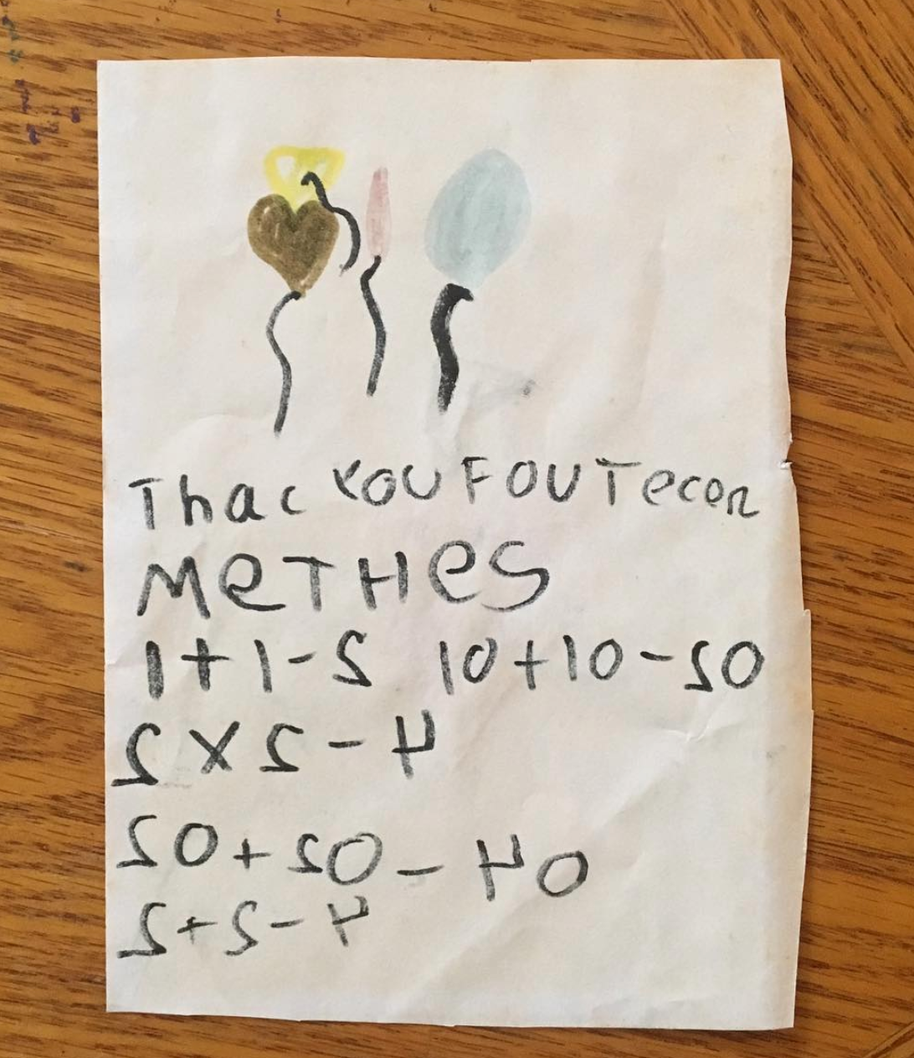

Introductions

Slide 4
Introductions
Your name
What you do for school, work, and/or fun
Why you signed up for this class
Have you ever used R before?

Slide 5
Housekeeping notes
Take a break whenever you need one, we will also have a few structured breaks as a larger group
Outlet locations
Trash cans
Try to come with a charged laptop
If you have questions, you can find me at sde31@georgetown.edu

Slide 6
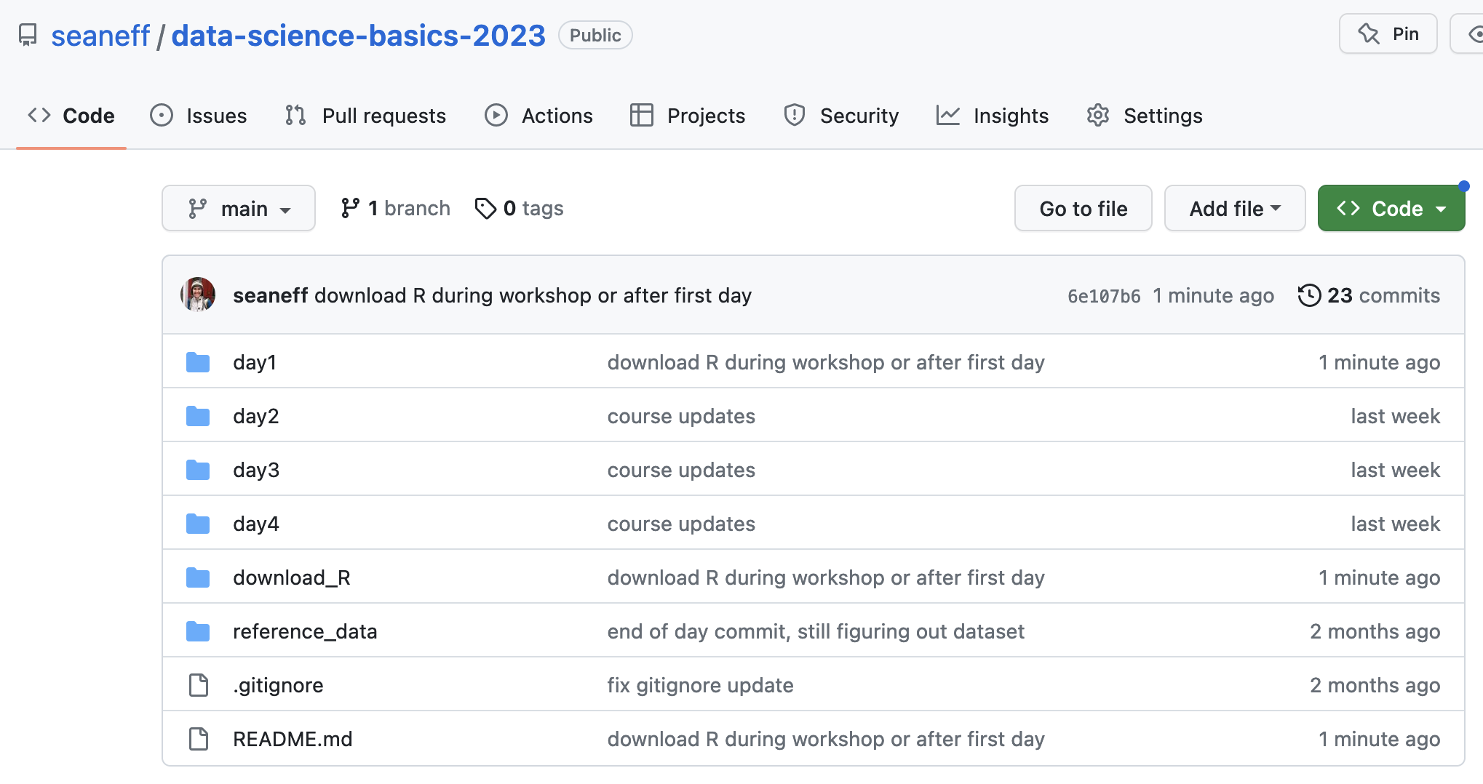
Housekeeping notes
All course materials are on github, and we’ll take more about github starting tomorrow
https://github.com/seaneff/data-science-basics-2023

Slide 7
What to expect: learning R
Learning R is fun! And also frustrating.
You won’t be an expert by the end of these 4 days.
But over time and as you practice, it gets easier!

Slide 8
What to expect: the next 4 days
We’ll balance slides/demos with hands-on exercises
You decide how you learn best
listening with your computer away
laptop out and typing along
taking notes with paper/pen
All of these slides, course notes, and other materials are publicly accessible on github

Slide 9
Workshop goals
This workshop will build literacy and basic proficiency in statistical programming, with a focus on the skills needed to conduct data analyses in professional healthcare and public health workspaces.
We will cover the basics of data management, data cleaning, data visualization, and basic statistical calculations in R, and version control in github. Participants will leave with a small portfolio of relevant data visualizations and analyses completed using a real‐world public health dataset.

Slide 10
Workshop goals
This workshop will build literacy and basic proficiency in statistical programming, with a focus on the skills needed to conduct data analyses in professional healthcare and public health workspaces.
We will cover the basics of data management, data cleaning, data visualization, and basic statistical calculations in R, and version control in github. Participants will leave with a small portfolio of relevant data visualizations and analyses completed using a real‐world public health dataset.
Learning to program (in R) can be fun, and doesn’t have to be overwhelming or intimidating

Slide 11
Learning by doing
For some people, it’s easier to learn by doing, typing, and making mistakes. I’m one of those people. Others prefer to listen, think, and work through problems later on their own.
In this workshop, we’ll pause to do worked examples. Sometimes these will be confusing. This is the point! We will learn together by trial and error.
If you are more comfortable following along, and you feel stuck, feel free to just watch and try at home. But I really encourage you to try, the best way to learn R is to repeatedly do stuff wrong and then figure out the errors.

Slide 12
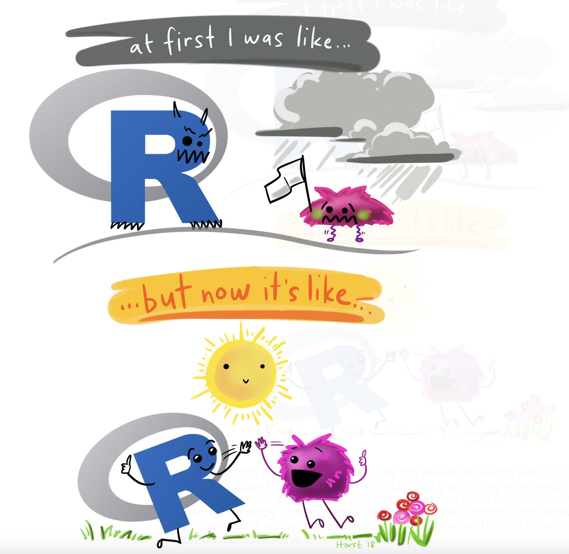
Artwork by Allison Horst
https://allisonhorst.com/everything-else

Slide 13
Goals for today
Understand what statistical programming is
Learn how to download R and RStudio
Get acquainted with Rstudio
Write your very first R code (at least, of this workshop)
vectors
functions
accessing documentation
Explore github to access course materials

Slide 14
What is statistical programming, and why should I care?

Slide 15
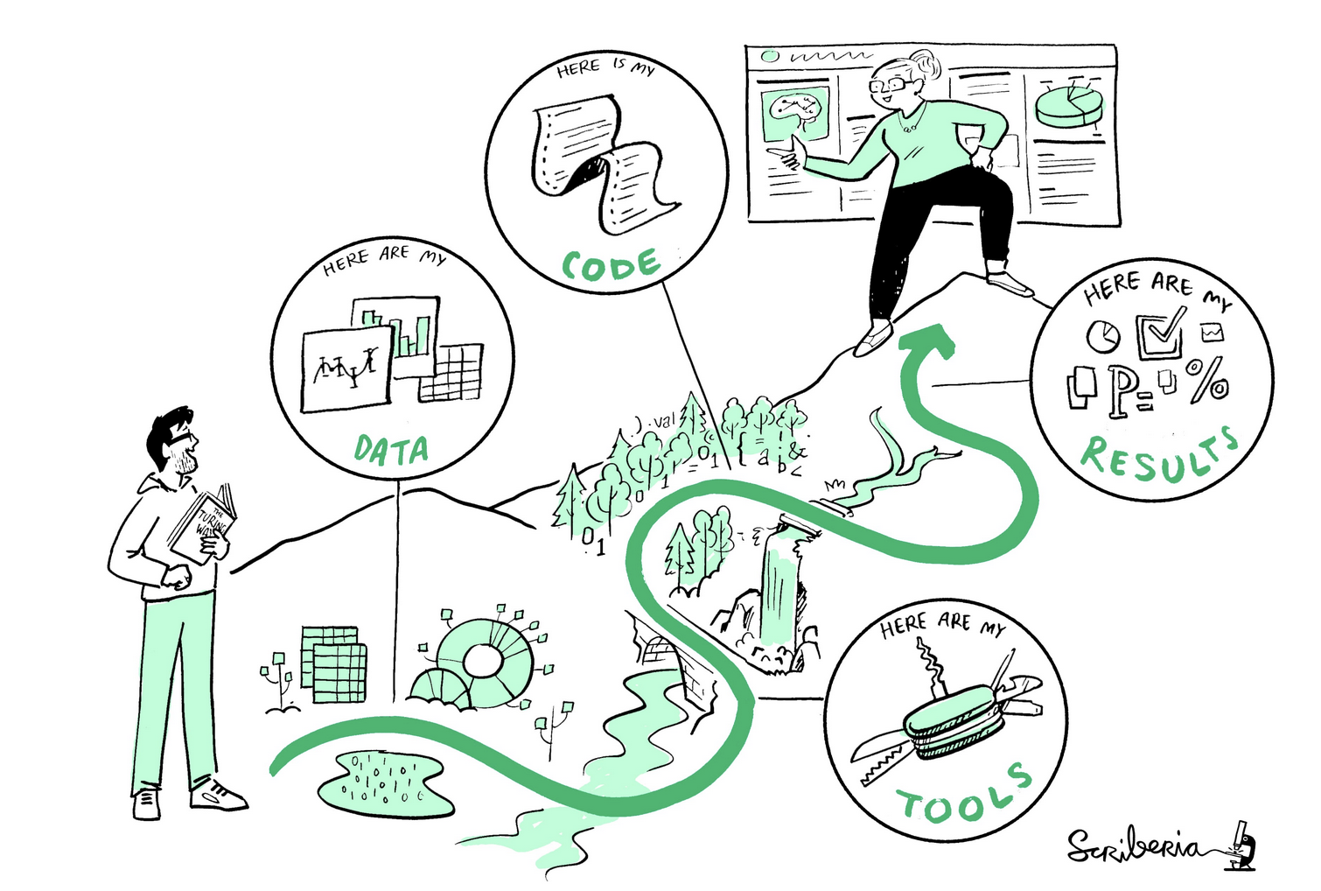
What is statistical programming?
Statistical programming is using code to clean, analyze, visualize, and interpret data.
This illustration is created by Scriberia with The Turing Way community. Used under a CC-BY 4.0 licence. DOI: 10.5281/zenodo.3332807

Slide 16

What is R?
R is a programming language for statistical computing
Created by Ross Ihaka and Robert Gentleman in 1996
R is open-source and free
Many people use R in different ways and for different purposes, but it’s defined specifically for data analysis and visualization (unlike other open-source languages like python)
Notes:
See original Ihaka and Gentleman publication https://www.jstor.org/stable/1390807

Slide 17

What is R Studio?
R Studio is, put simply, a place to write and run R code
It’s an IDE (integrated development environment) and supports both R and python
It’s also free (with enterprise upgrades)
Artwork by Allison Horst
https://allisonhorst.com/everything-else

Slide 18
Why learn R?
Learning R helps you understand your data and understand how analysis works, whether you’re a researcher, a data scientist, or someone who collaborates with folks who do analysis
Coding helps you think rigorously about your questions
It’s free (vs. other more expensive tools like SAS or SPSS)
Sharable, reproducible code and research
Lots of academics/companies/agencies use it
It’s fun (honestly)

Slide 19
Getting acquainted with RStudio

Slide 20
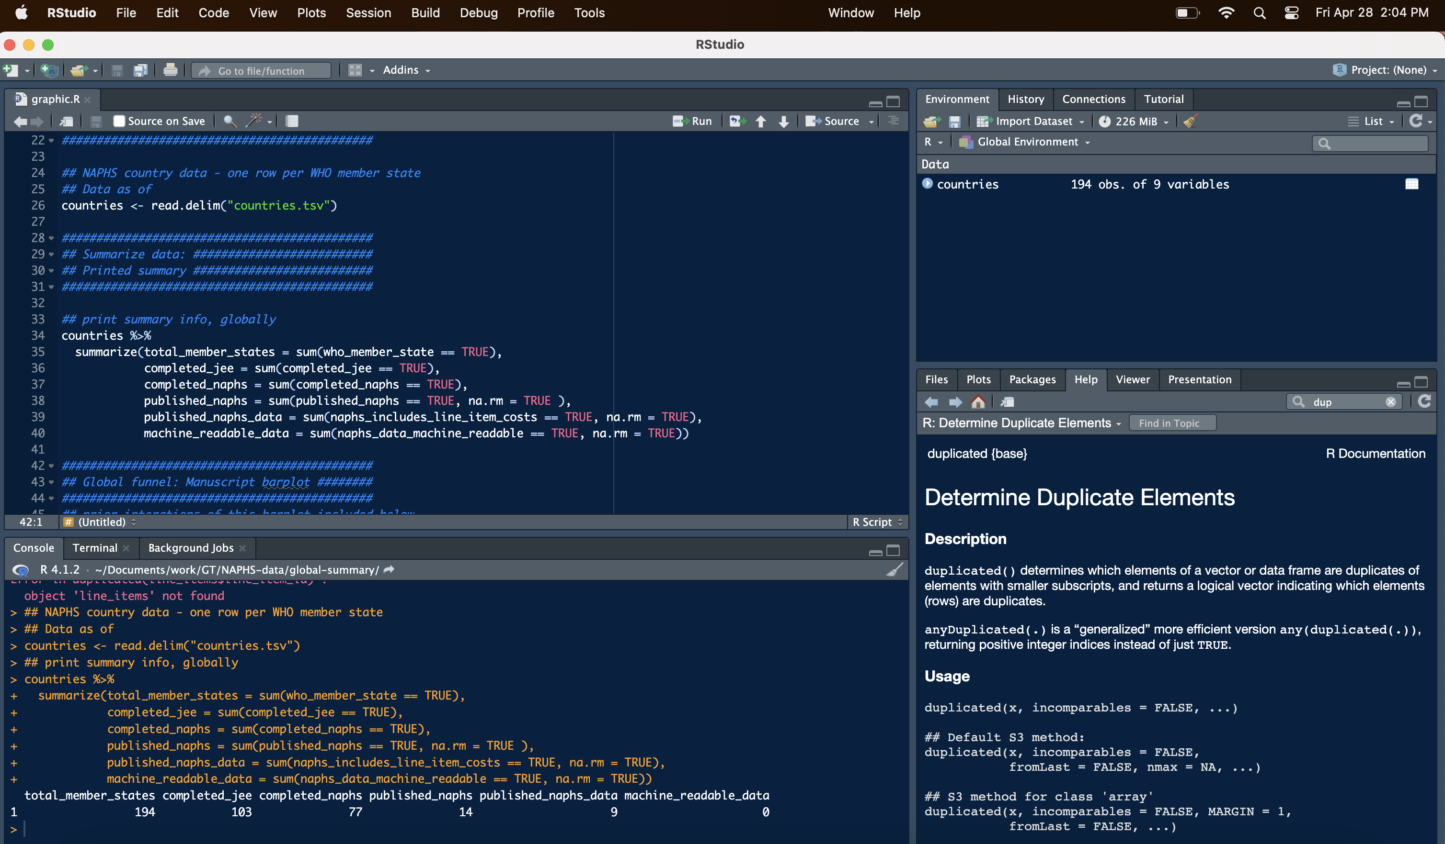
R Studio Console
Notes:
See more information here: https://intro2r.com/rstudio_orient.html#cons

Slide 21
R Studio Console
Write R scripts to re-use (.R files)
Notes:
See more information here: https://intro2r.com/rstudio_orient.html#cons

Slide 22
R Studio Console
This button runs code
(easier to see on your laptop)
Run one-off code here, or see the results of code you ran from above
Notes:
See more information here: https://intro2r.com/rstudio_orient.html#cons

Slide 23
R Studio Console
Stuff you have in memory
(e.g., datasets)
Notes:
See more information here: https://intro2r.com/rstudio_orient.html#cons

Slide 24
R Studio Console
Documentation and figures
Notes:
See more information here: https://intro2r.com/rstudio_orient.html#cons

Slide 25
Downloading R and R Studio

Slide 26
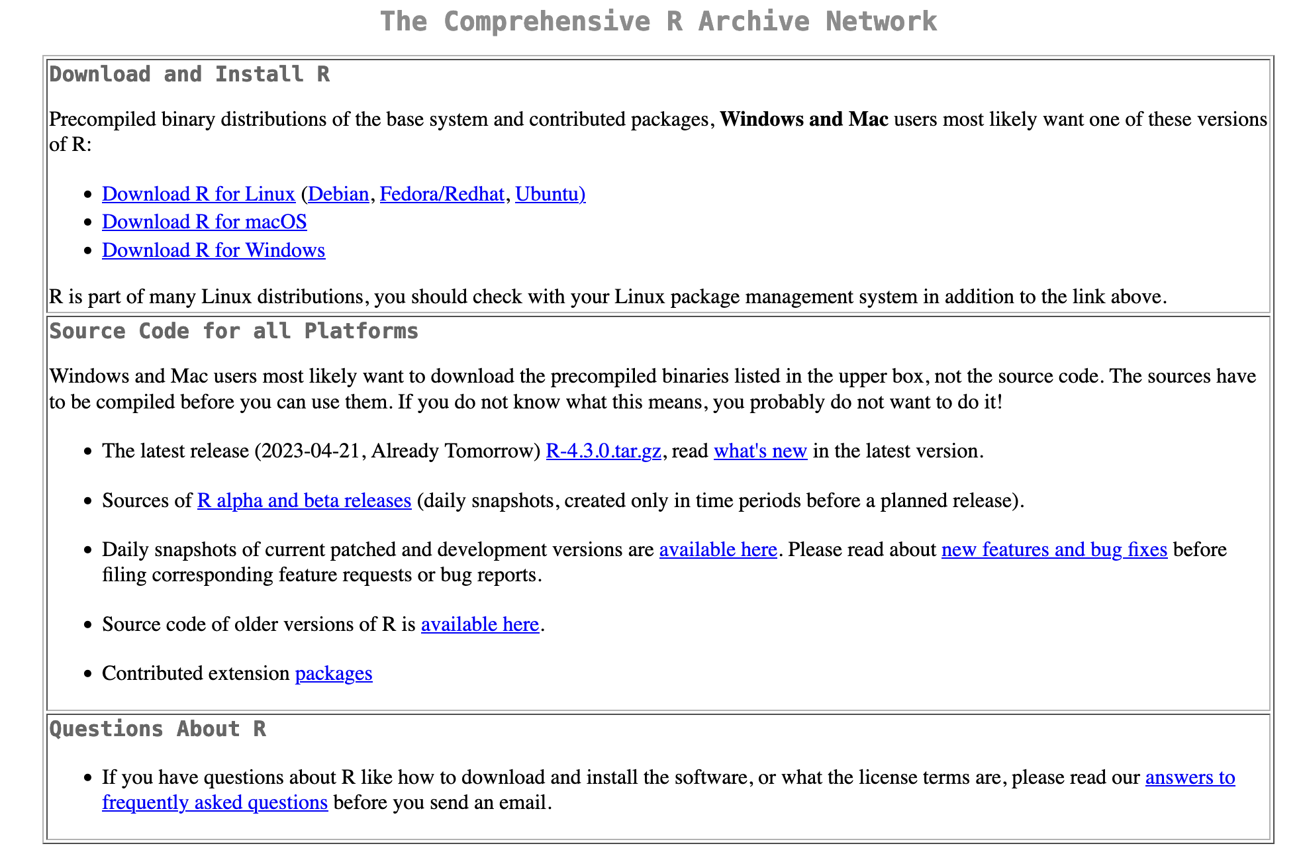
Download R:
https://cran.r-project.org/

Slide 27
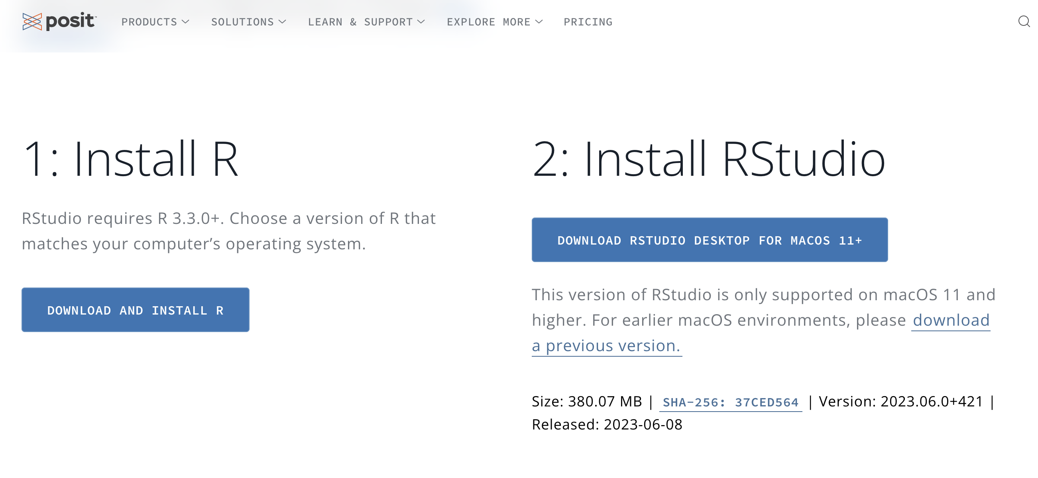
Download RStudio:
https://posit.co/download/rstudio-desktop/#download

Slide 28
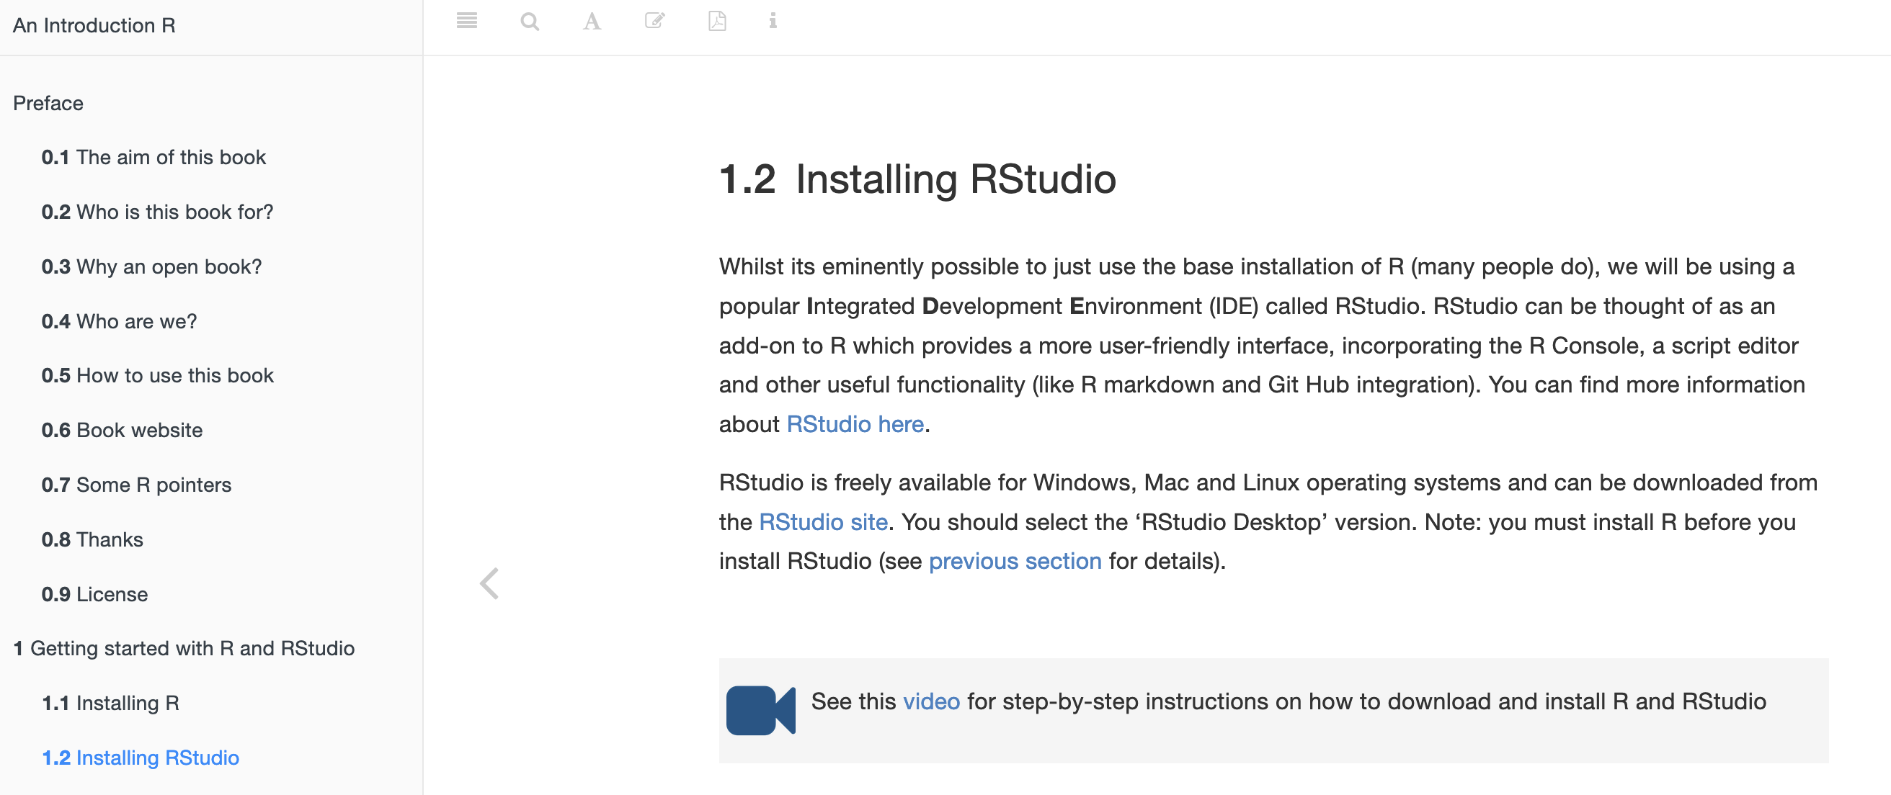
For videos and more help:
https://intro2r.com/installing-rstudio.html

Slide 29
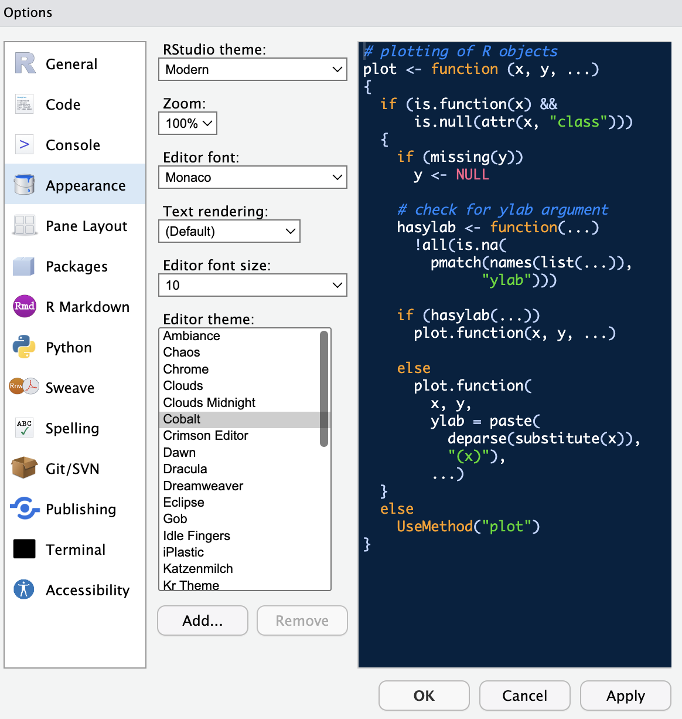
Changing R Studio Appearance
Navigate from the top bar
-> Tools
-> Global options
-> Appearance
(then click “apply”)

Slide 30
15 minute break
(and a note on worked examples)
If possible, try to download R and Rstudio before tomorrow’s class. I’ll be around by Zoom or email if you have any questions, and can help troubleshoot.
Today, we’ll do some worked examples sharing my laptop. If you already have R and Rstudio installed on your laptop, feel free to follow along there.

Slide 31
R Basics

Slide 32
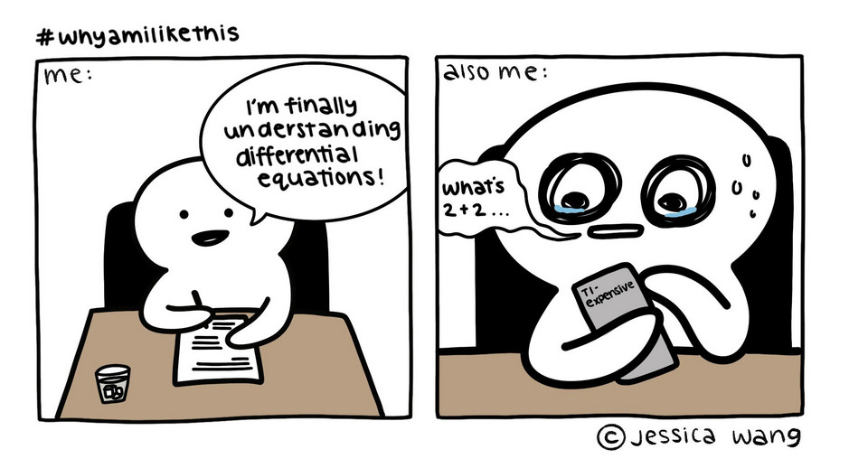
Using R as a Calculator
R can do everything a basic calculator can do
Using R as a calculator is a great first step
Comic by Jessica Wang. Accessed online: https://i.redd.it/dmayt2tc3e551.jpg

Slide 33
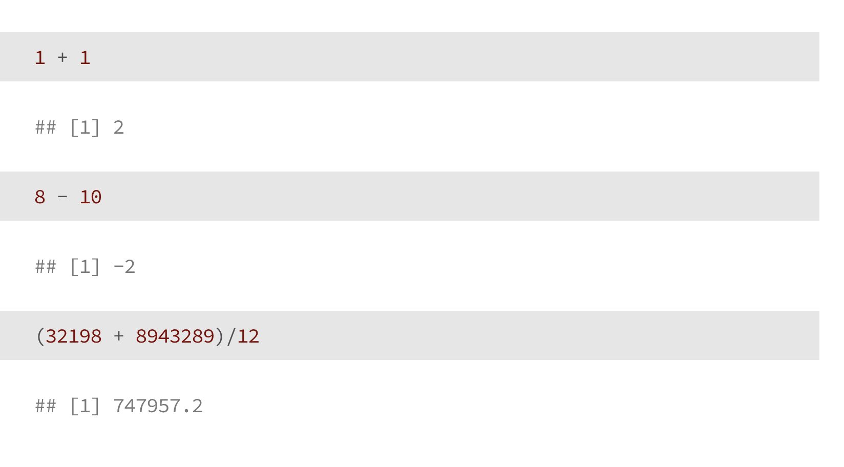
Using R as a Calculator

Slide 34
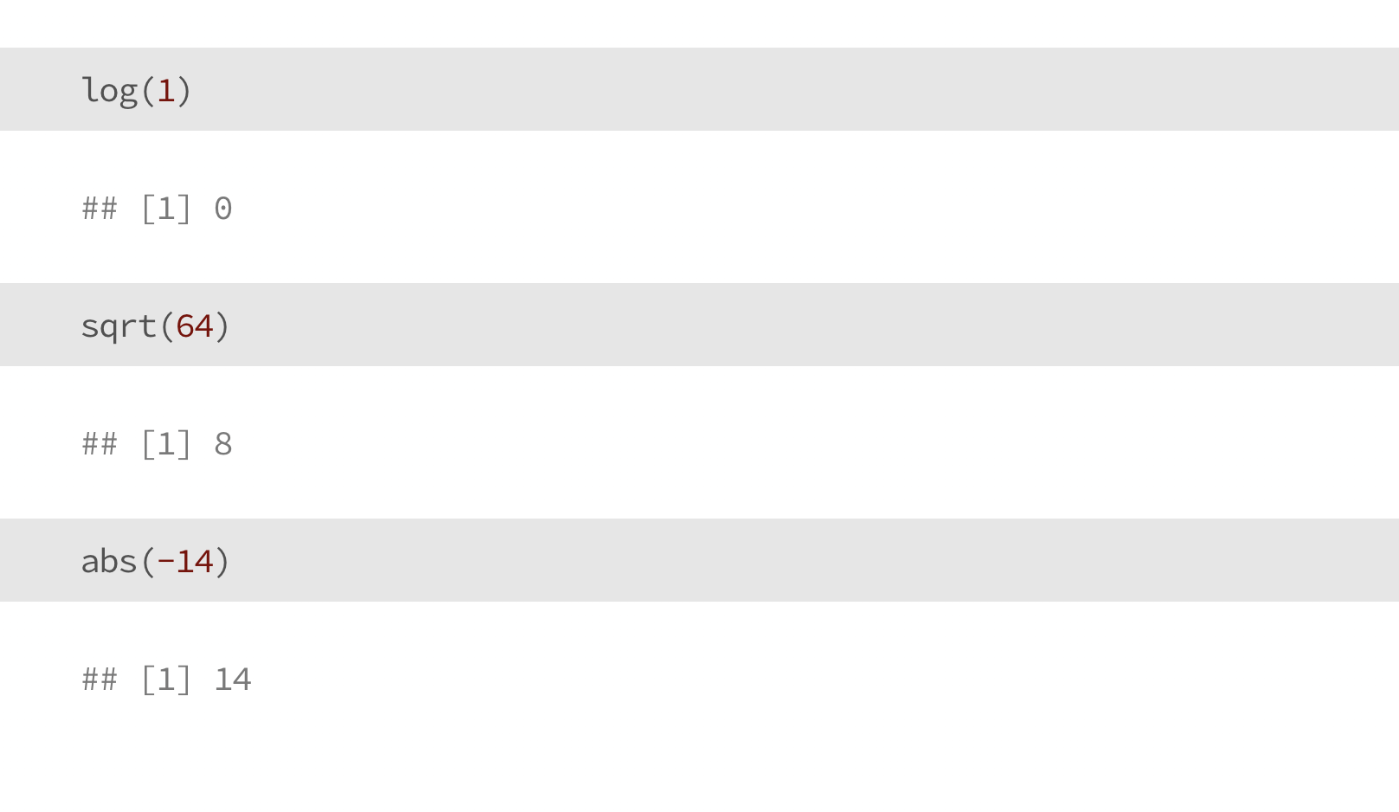
Using R as a Calculator

Slide 35
Using R as a calculator:
Symbols and Syntax
Addition (1+1)
Subtraction (2-1)
Multiplication (3*4)
Division (7.2/9)
Exponents (2^7)
Square root ( sqrt(9) )
Order of operations ( 7/(3*2) )

Slide 36
Now you try!
Use R to do some math?
Add two numbers together
Multiply three or more numbers
Take the square root of a number

Slide 37
Objects
An object is something you save to R’s working memory
It can be almost anything
A string (e.g., your name)
A number (e.g., 3.14)
A dataset (e.g., that file you have in Excel)
We assign objects using a little arrow with the syntax (<-)
When doing data analysis, the most common object you’ll probably save is a dataframe, like an Excel or .csv file that you can access from within R (more on this later)

Slide 38
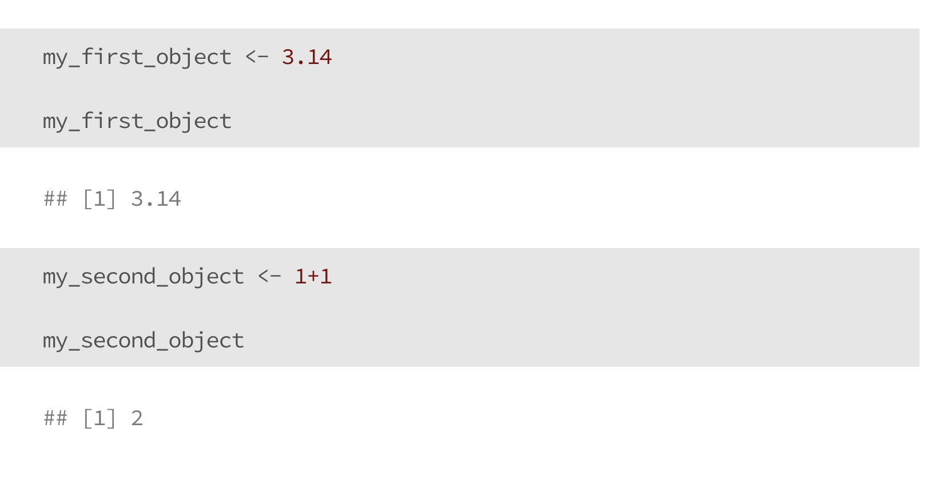
Objects

Slide 39
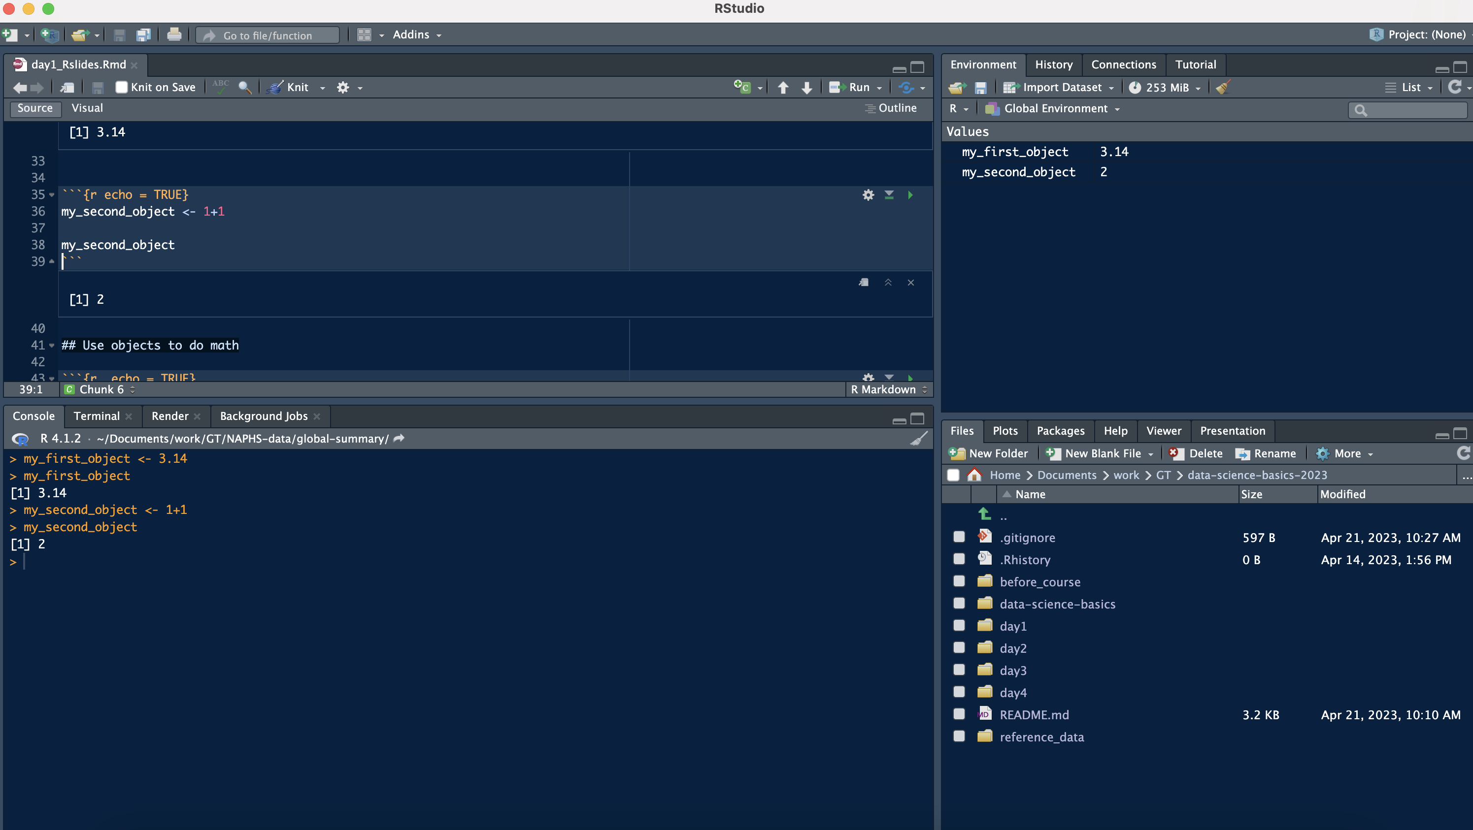
Objects
Our new objects are shown in this corner

Slide 40
Use (numeric) objects to do Math
Just like we did when we used R as a calculator, you can also use numeric objects to do math
When you do this, the objects themselves don’t change unless you explicitly re-assign them to new variables

Slide 41
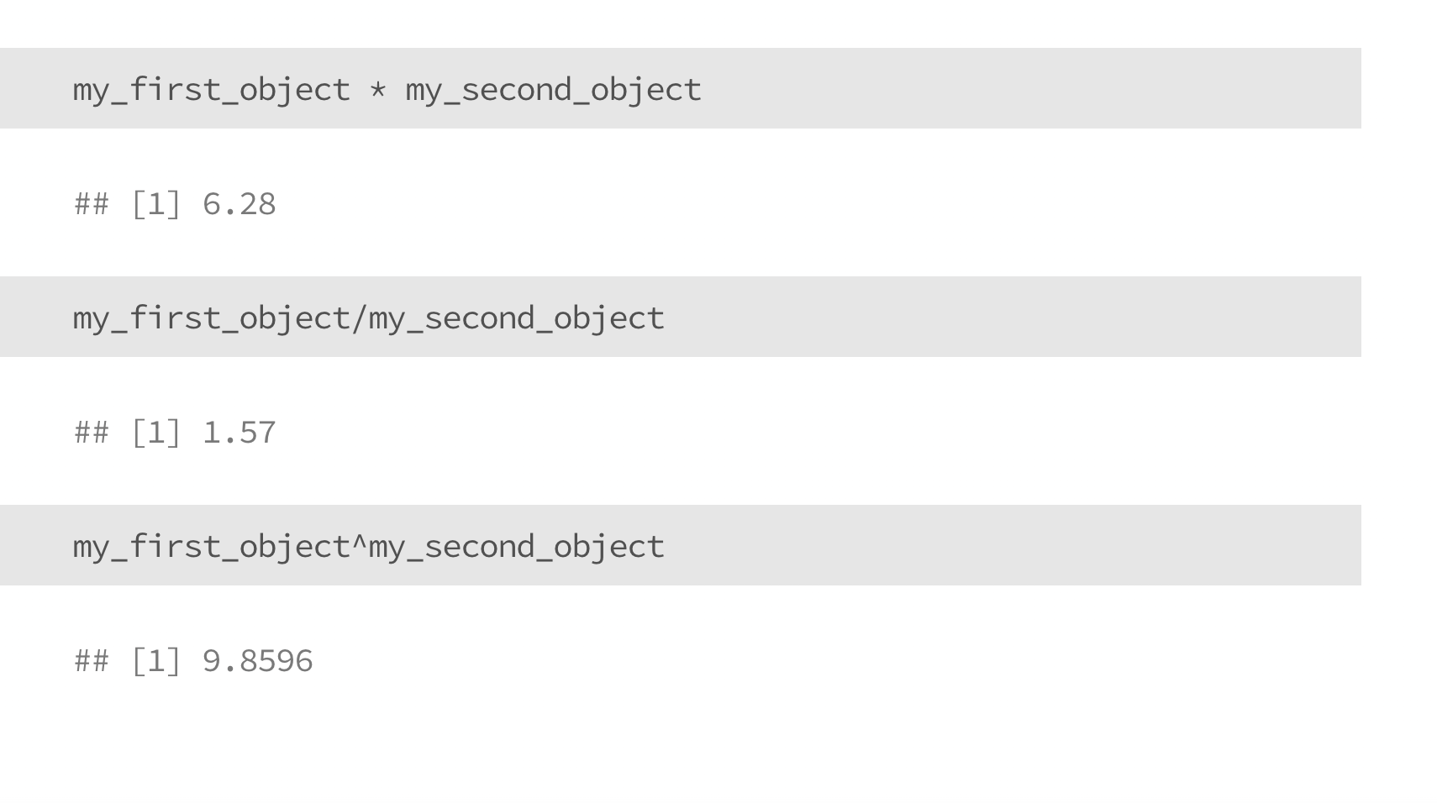
Use (numeric) objects to do Math

Slide 42
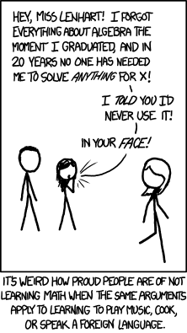
Now you try!
Pick your favorite number, and save it as an object
Pick another number, and save it as another object
Do one basic calculation (e.g., addition) with your objects
(You may run into issues, that’s okay! We’ll talk them through.)
Figure credit: XKCD

Slide 43
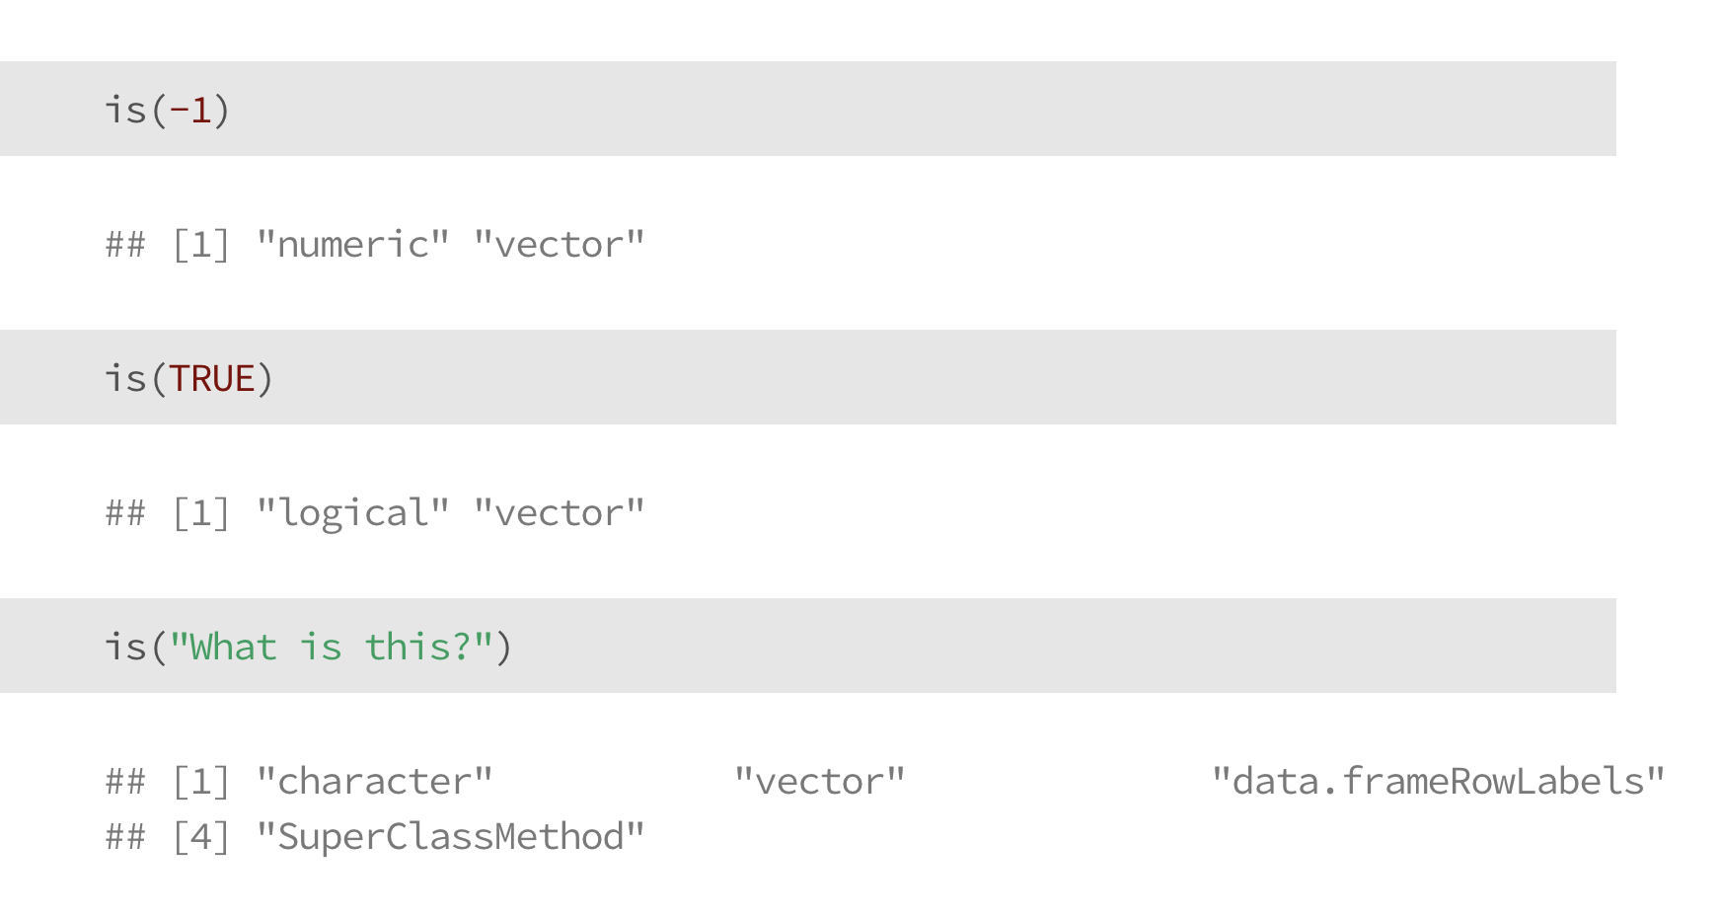
Data types in R
numeric: a number (e.g., -1, 0, 893243.343)
logical: TRUE or FALSE (no quotations)
character: letters and words (tricky – or a number stored as a string)
is() will help us learn the data type of a given object

Slide 44
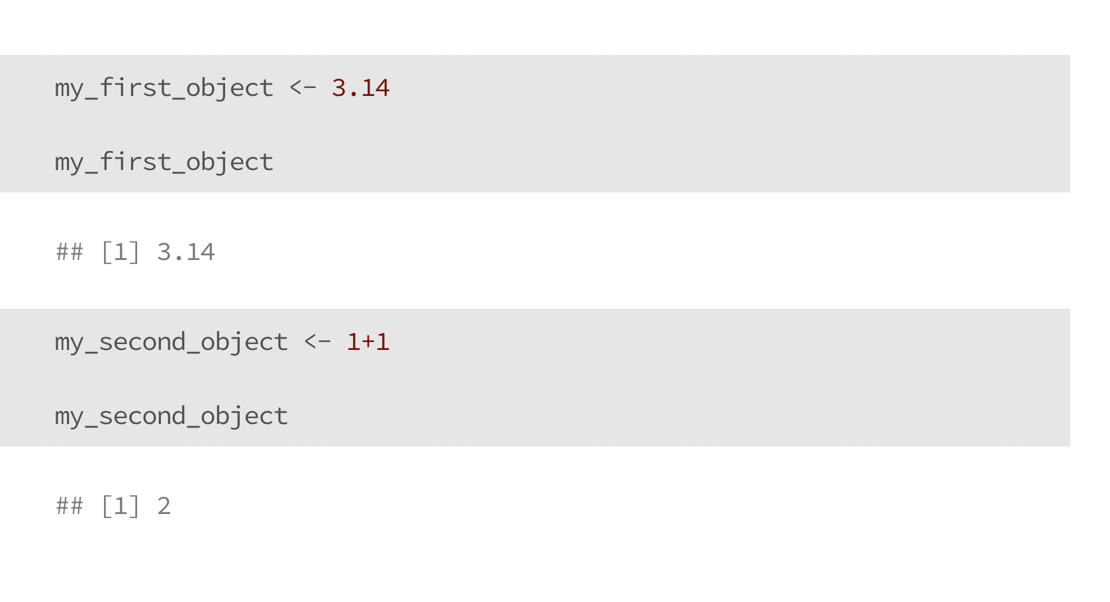
Numeric Data

Slide 45
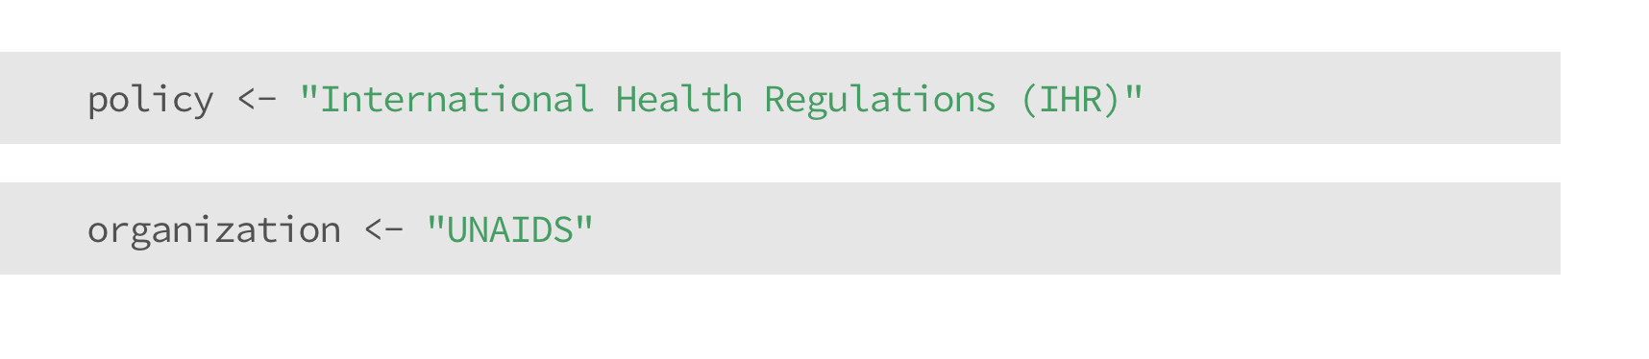
Character Data

Slide 46
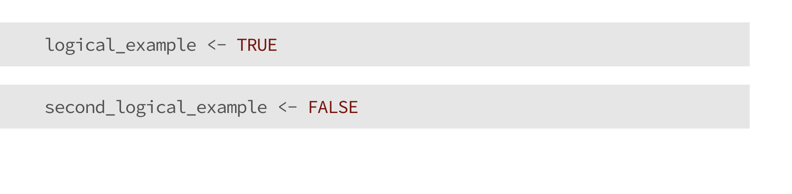
Logical Data

Slide 47
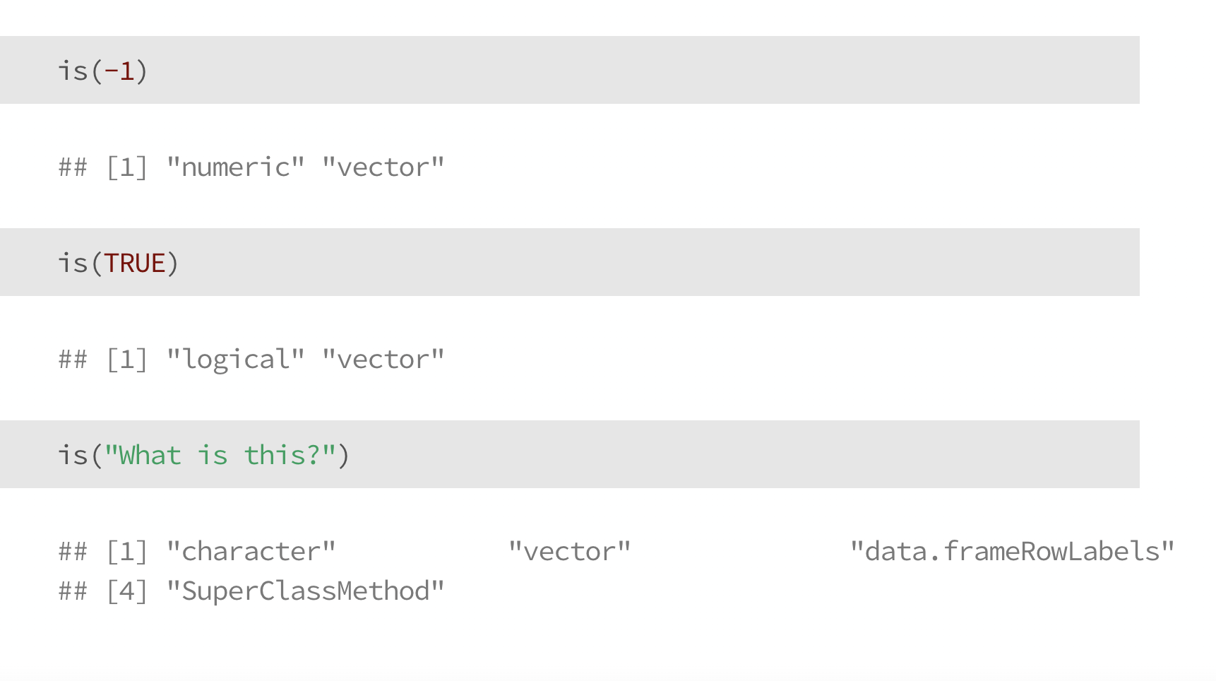
Check your understanding

Slide 48
Check your understanding

Slide 49
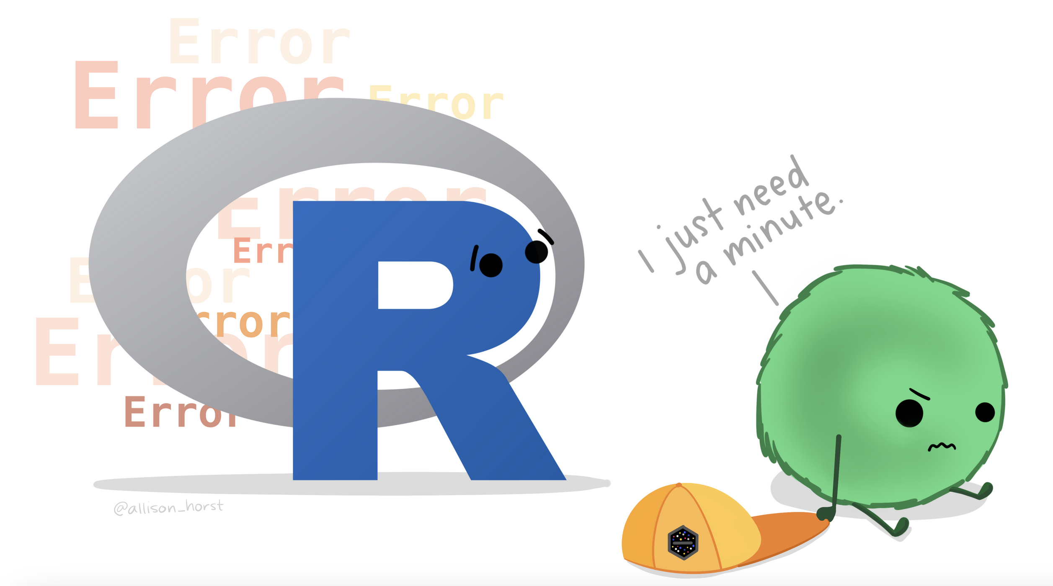
Artwork by Allison Horst
https://allisonhorst.com/everything-else

Slide 50
Rules for naming objects
General naming requirement: a variable name can’t start with a number or a dot (.)
R is case sensitive (‘A’ is different than ‘a’)
General rules of thumb: aim for consistency
snake_case
camelCase
whatever.this.is
Chose a name you’ll understand when you open your code the next day, or when someone else reviews it
Notes:
See more information here: https://intro2r.com/objects-in-r.html#naming-objects

Slide 51
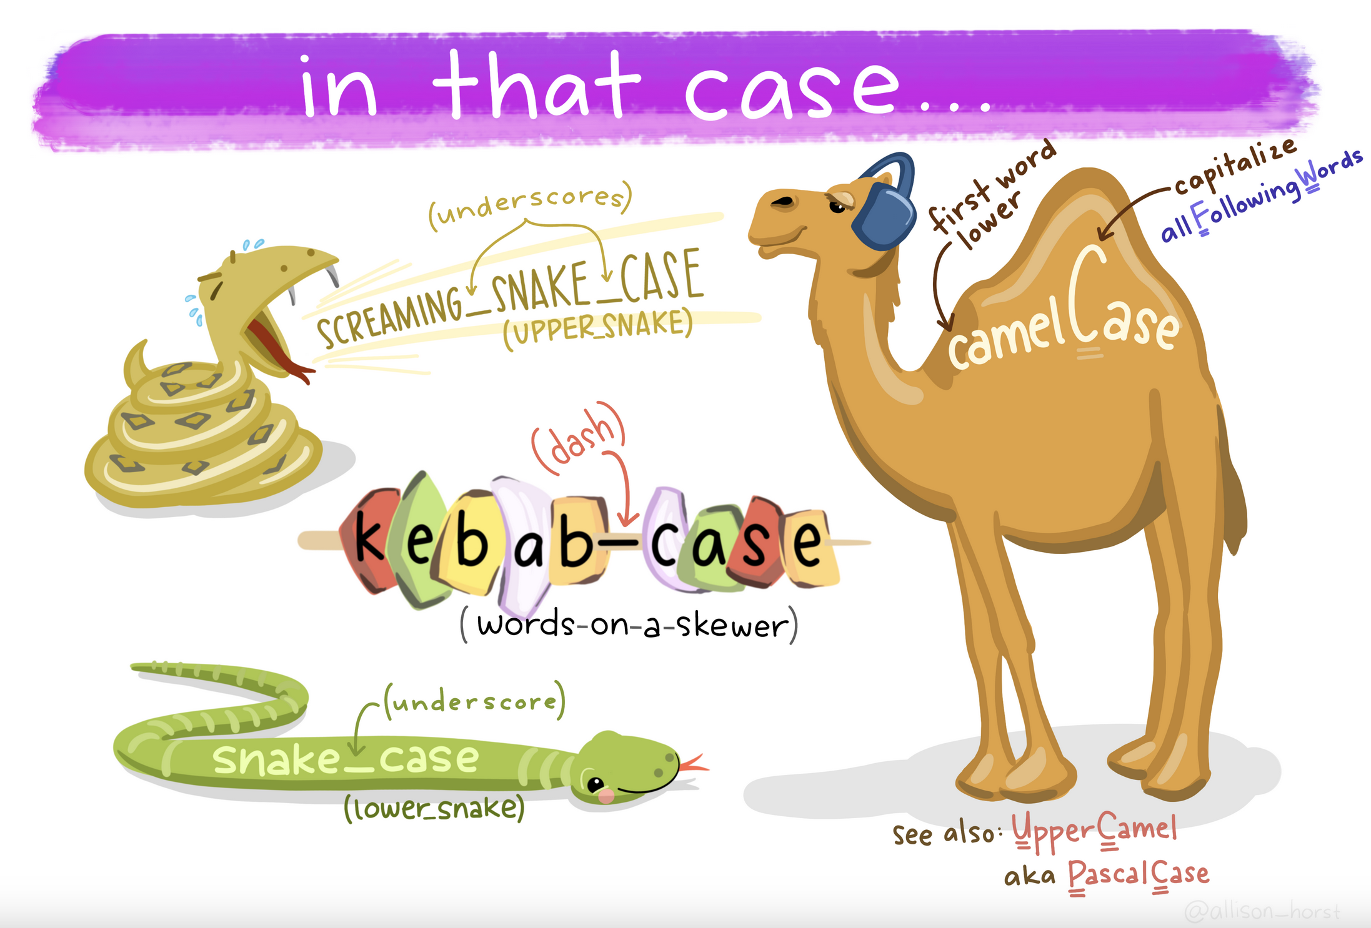
Artwork by Allison Horst
https://allisonhorst.com/everything-else

Slide 52
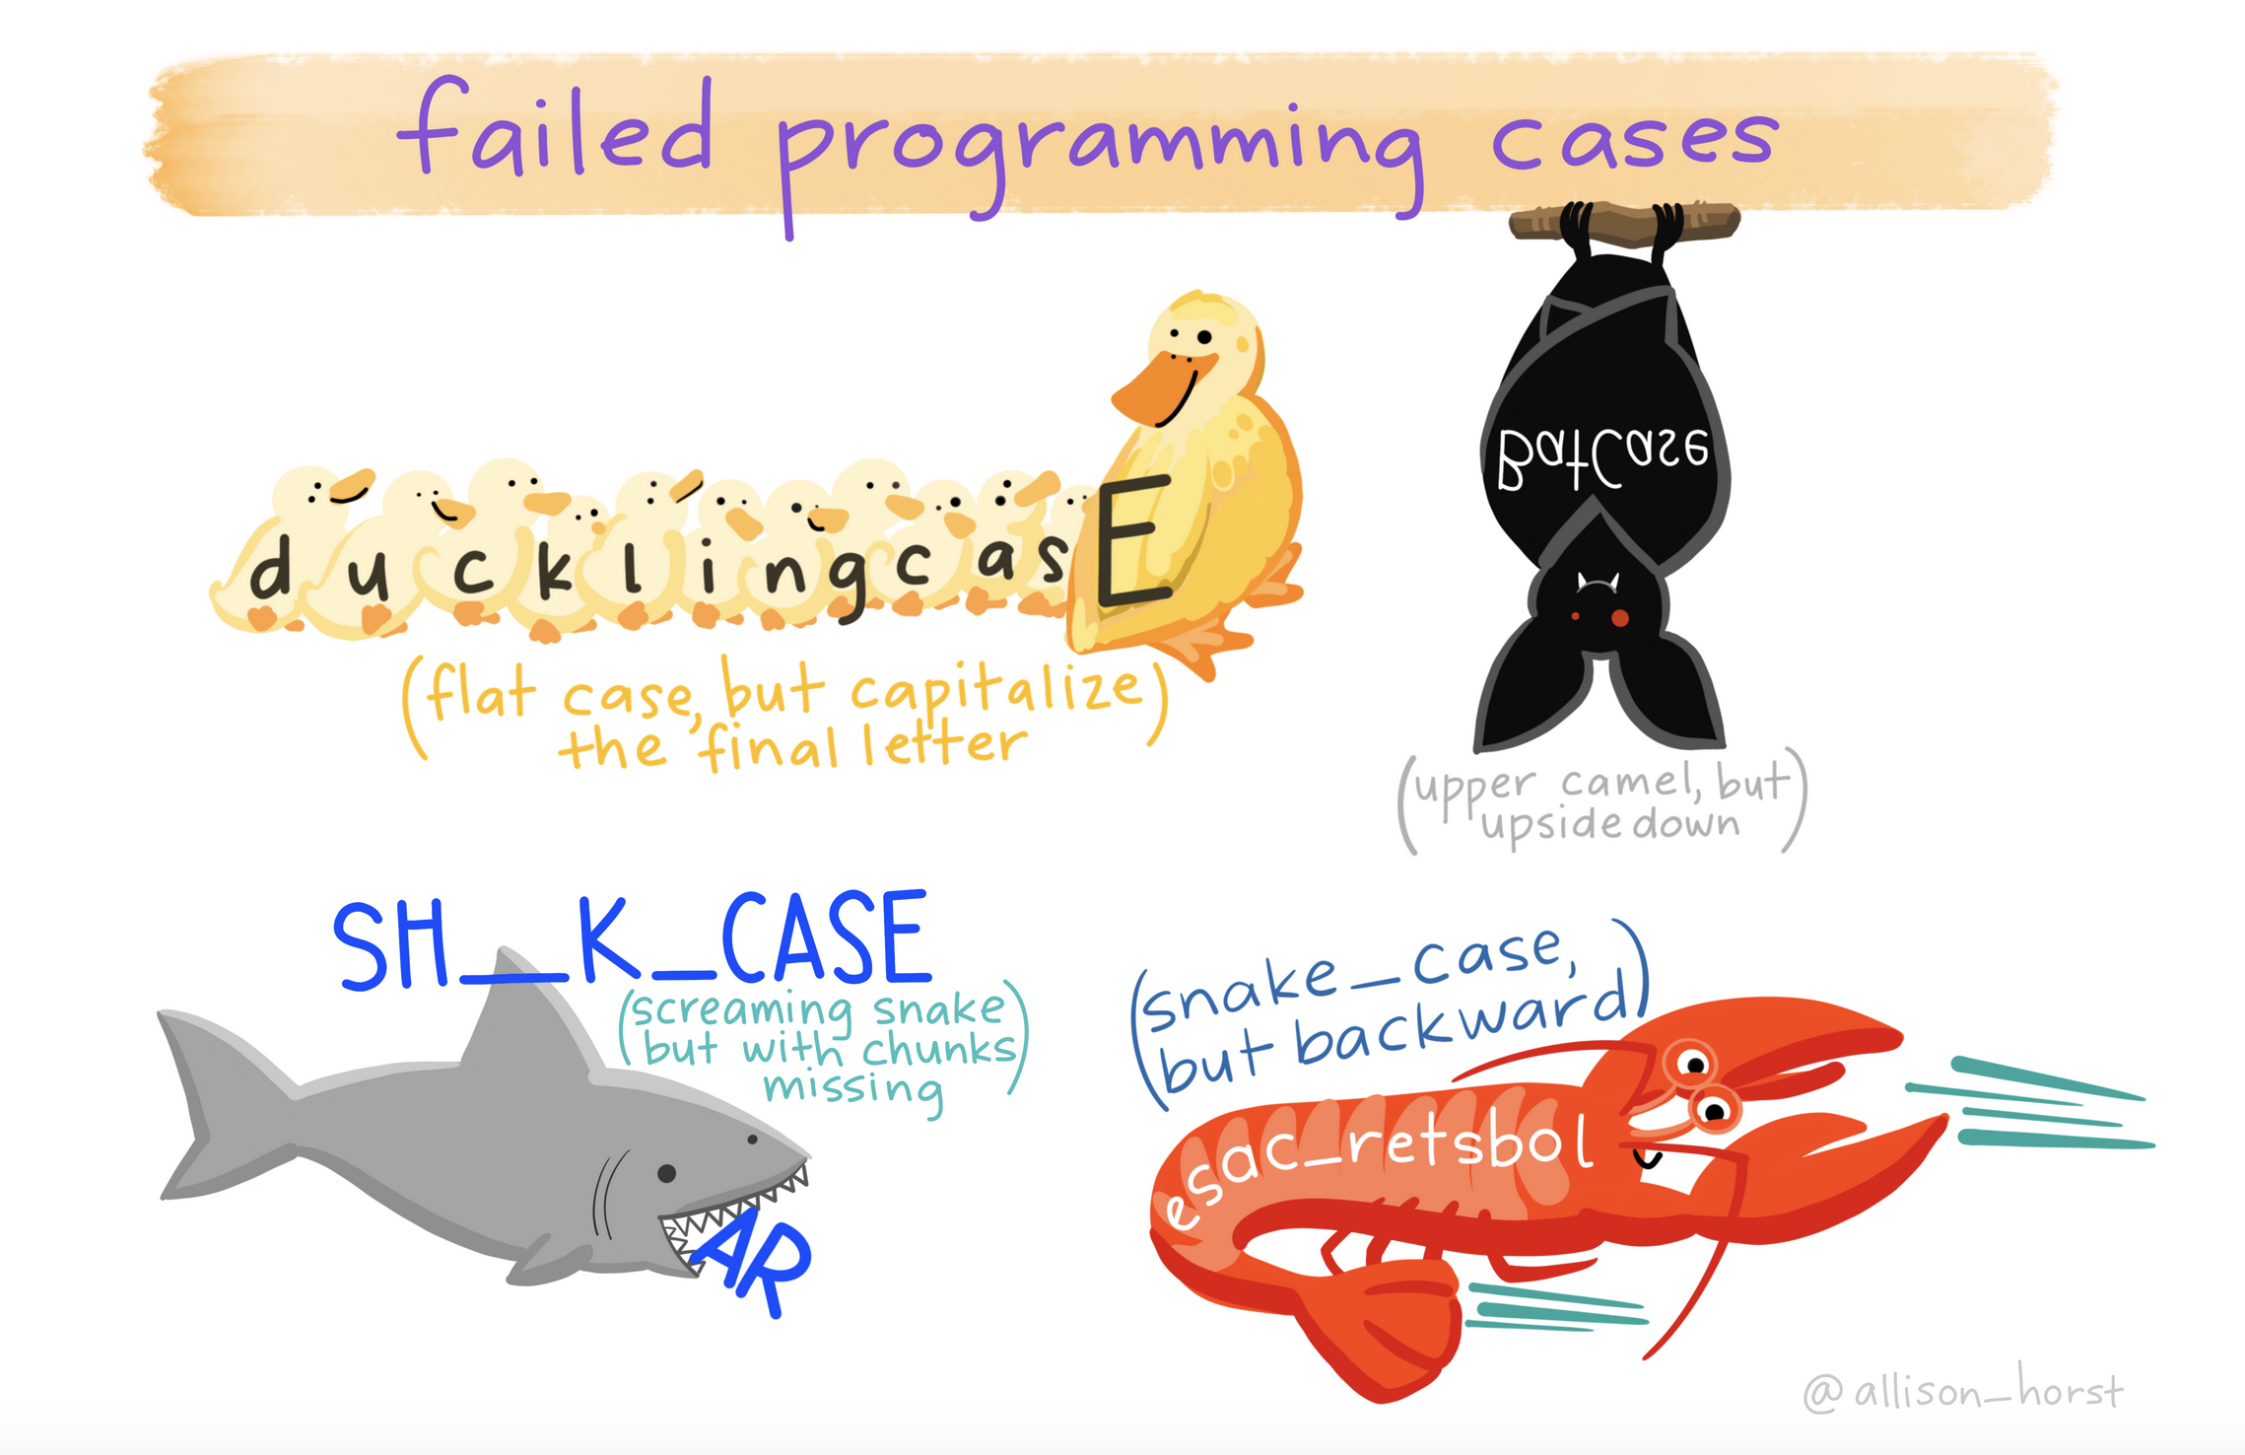
Artwork by Allison Horst
https://allisonhorst.com/everything-else

Slide 53
Now you try!
Create three new objects, with any allowable names you want. Try to use a consistent naming style.
Numeric (we already did this, but practice is good)
Character
Logical

Slide 54
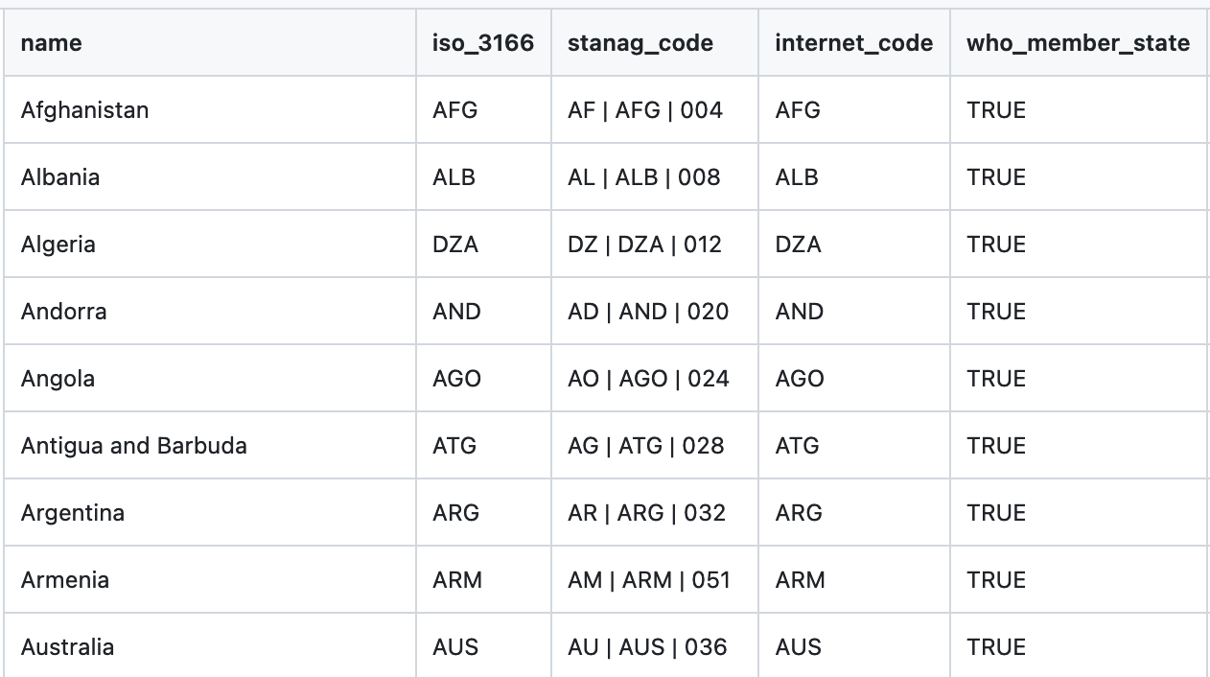
Vectors
Each column is a vector
Vectors are grouped data elements in a specific order
For example, data in a specific column in Excel
When you’ve thought previously about data analysis, you probably think about vectors, even if you didn’t use that name
Notes:
See more information here: https://intro2r.com/using-functions-in-r.html

Slide 55
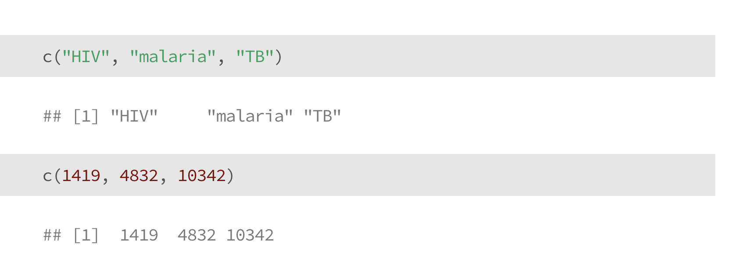
Vectors
Notes:
See more information here: https://intro2r.com/using-functions-in-r.html

Slide 56
Vectors
The c() stands for “concatenate”
Notes:
See more information here: https://intro2r.com/using-functions-in-r.html

Slide 57
Vectors
Vectors can contain strings
Or numbers
Notes:
See more information here: https://intro2r.com/using-functions-in-r.html

Slide 58
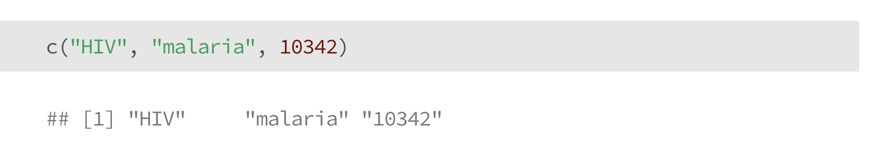
Vectors
Vectors can contain strings
Or numbers
… but not both
What happened here?
Notes:
See more information here: https://intro2r.com/using-functions-in-r.html

Slide 59
Now you try!
Make two vectors in R and assign them to objects.
Numeric
String

Slide 60
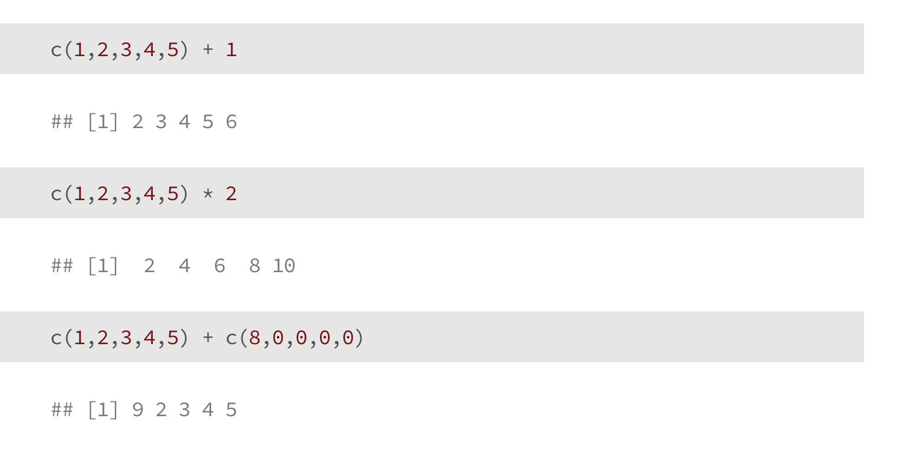
Vectorized Calculations

Slide 61
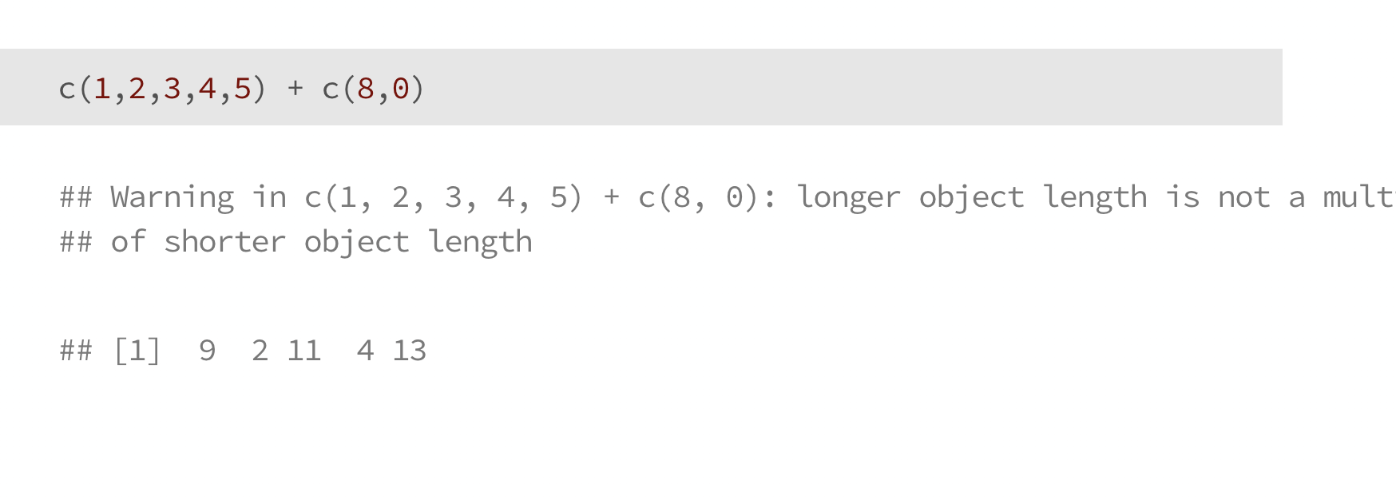
Vectorized Calculations

Slide 62
Functions
Functions are instructions to perform a task
They are algorithms, or consistent set of rules
R has built-in functions for many basic things
Functions generally look like this: function(object)
We can also “add on” extra functions by loading new libraries (we’ll get to this later), or we can write our own functions to do whatever we want

Slide 63
Functions
Most functions in R are vectorized
This means they act on all items in a vector
Why does this matter?
If you misunderstand it, your math will be wrong
It’s useful for basic calculations and analysis:
divide all numbers by 100 to calculate a %
multiply per-capita rates by total population

Slide 64
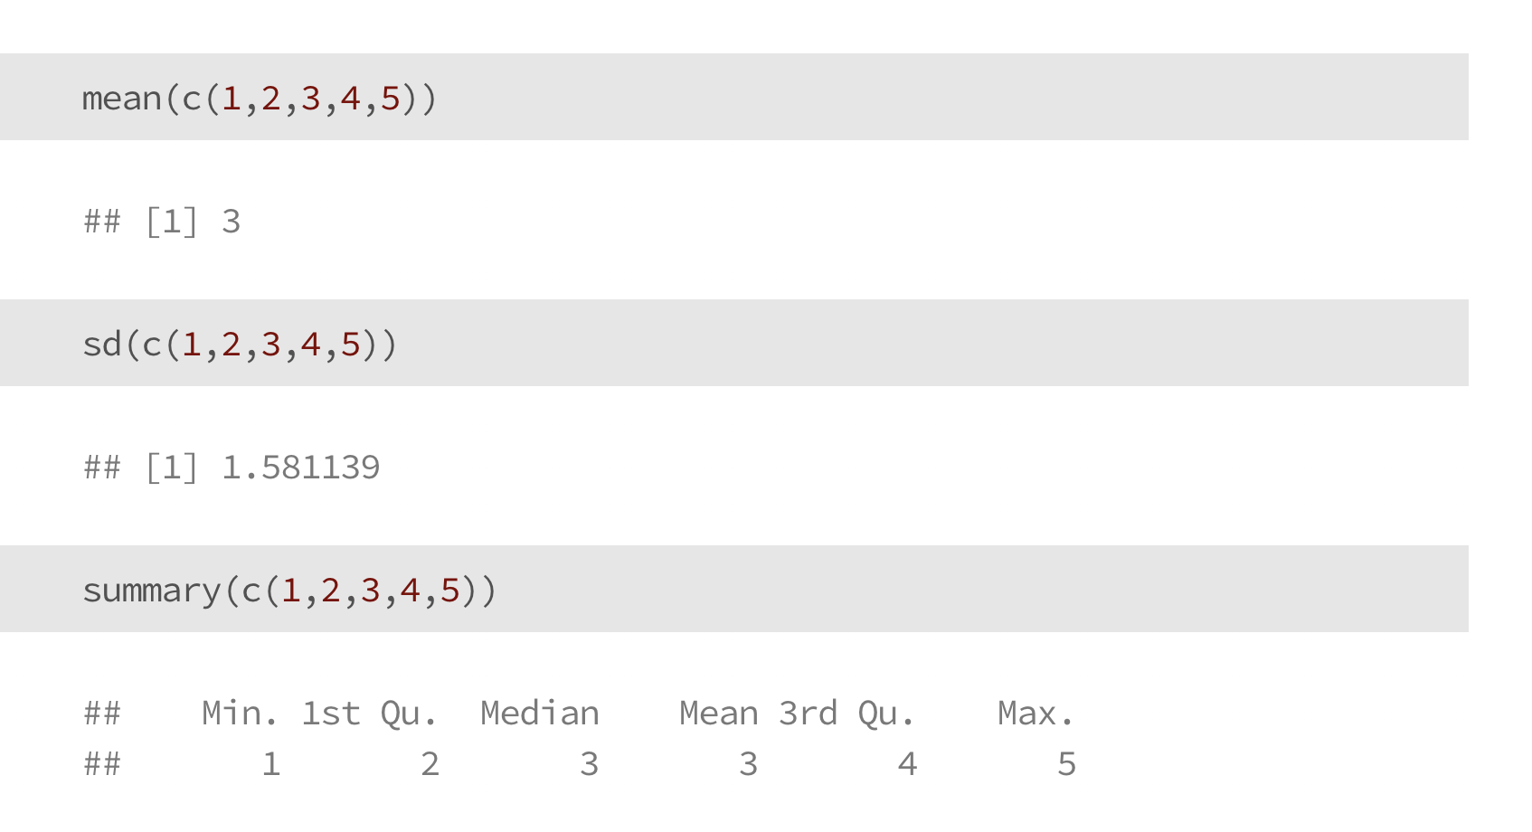
Functions

Slide 65
Functions

Slide 66
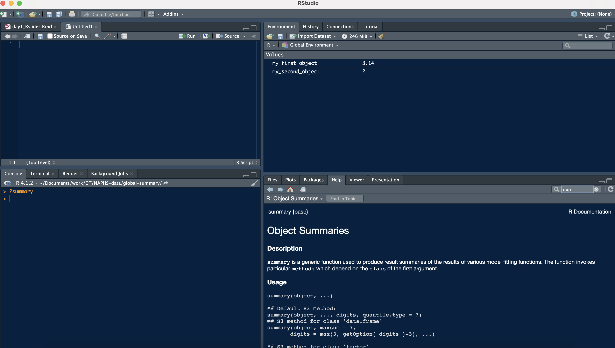
Learn more about functions
?summary or help(summary)
This is documentation about the summary() function
Type ? and then the function name:
?summary
?sd
?mean
etc…

Slide 67
Now you try!
Take the average of three or more numbers
Use “?” to learn more about the function sd()

Slide 68
Accessing course materials

Slide 69
What is github?
Have you ever saved a bunch of versions of a paper on your computer with different file names at different dates or times of day?
Backups are useful to save progress, understand what we’ve done before, and look into problems/bugs
Github is a tool do help do this with code

Slide 70
What is github?
We’ll talk more about github later in this workshop. For now, I’d like you to be able to use it to access course materials any time you’d like to.
https://github.com/seaneff/data-science-basics-2023

Slide 72
Day 2 course materials are in this folder

Slide 73
Now you try!
Open the course github and click around for a few minutes
https://github.com/seaneff/data-science-basics-2023

Slide 74
Thank you!
See you tomorrow.
Please come with a fully charged laptop.
Lecture and course material adapted from Intro to R materials created by Alex Douglas, available online here, with corresponding free online textbook.

